Slide 1



Advanced Water Level Monitoring Systems: Enhancing Precision and Reliability

Slide 2
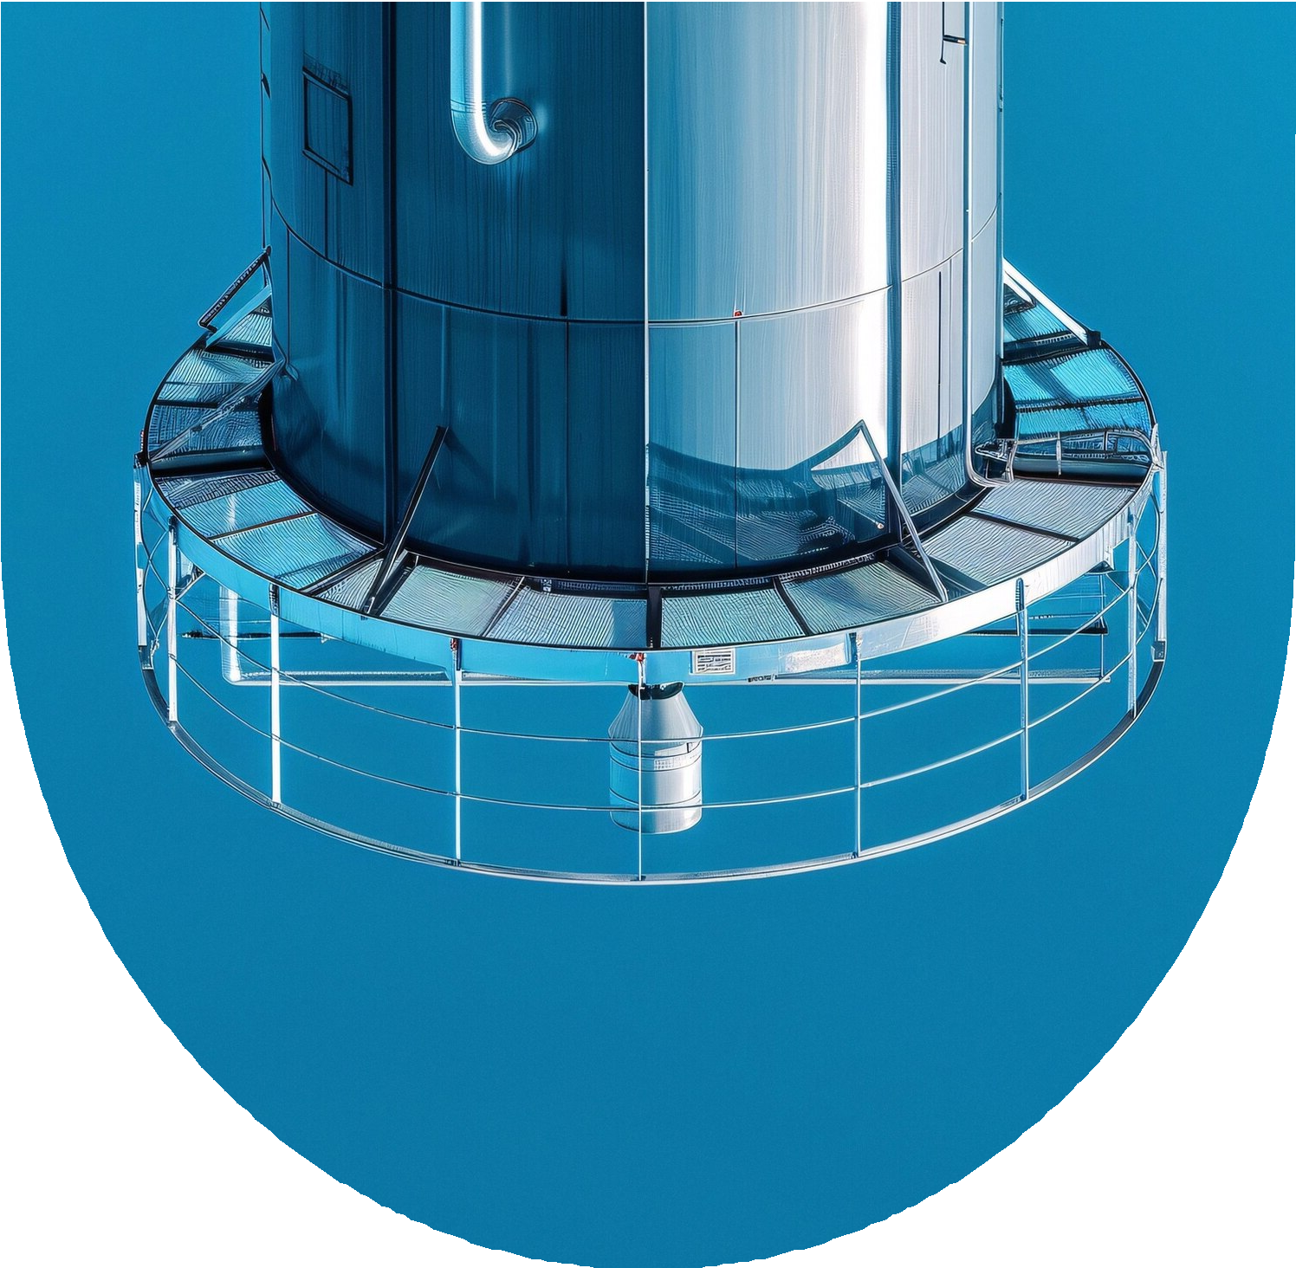


Introduction to Water Level Monitoring
Advanced Water Level Monitoring Systems are crucial for managing water resources. These systems enhance precision and reliability in measuring water levels, which is essential for flood control, irrigation, and environmental protection. This presentation will explore the latest technologies and methodologies in this field.

Slide 3


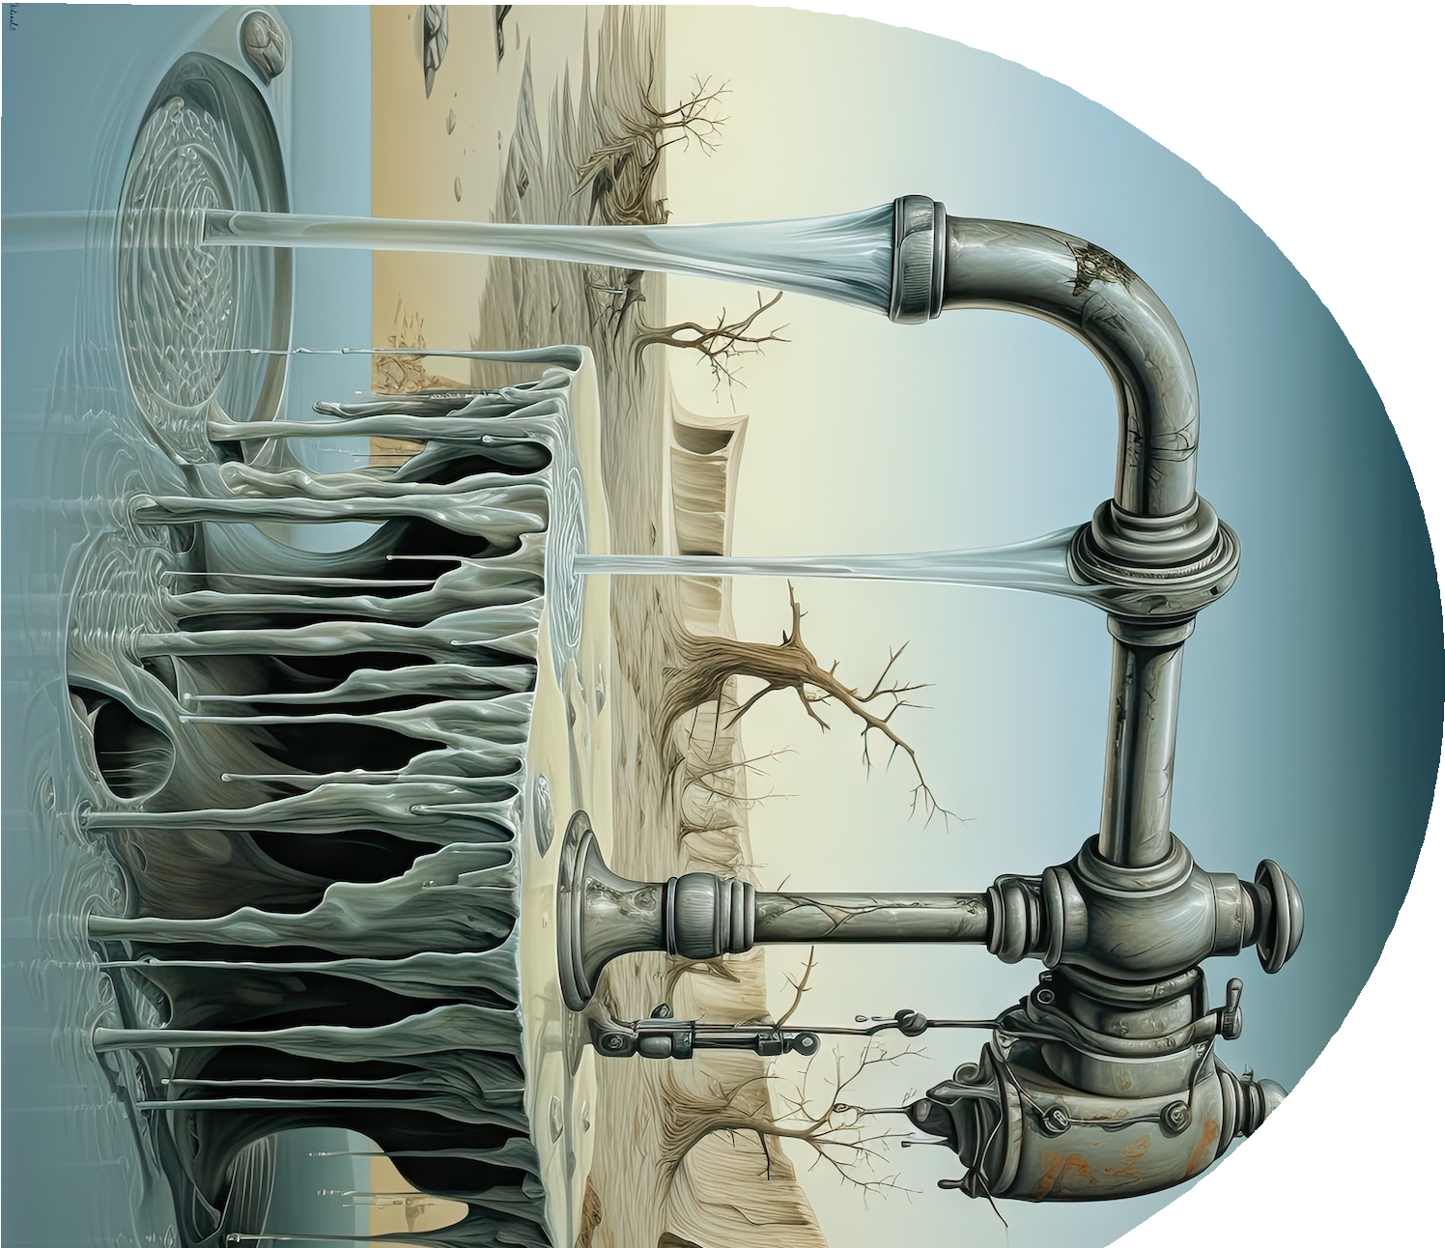

Importance of Precision
Achieving high precision in water level monitoring is vital for eﬀective decision-making. Accurate data helps in predicting floods, managing reservoirs, and ensuring safe drinking water supplies. This slide discusses the implications of precision in monitoring systems and its impact on resource management.

Slide 4

Technological Innovations
Recent technological advancements have revolutionized water level monitoring.
Innovations such as ultrasonic sensors, radar technology, and IoT integration provide real- time data and remote monitoring capabilities. This slide highlights key technologies that enhance system eﬀectiveness and reliability.

Slide 5

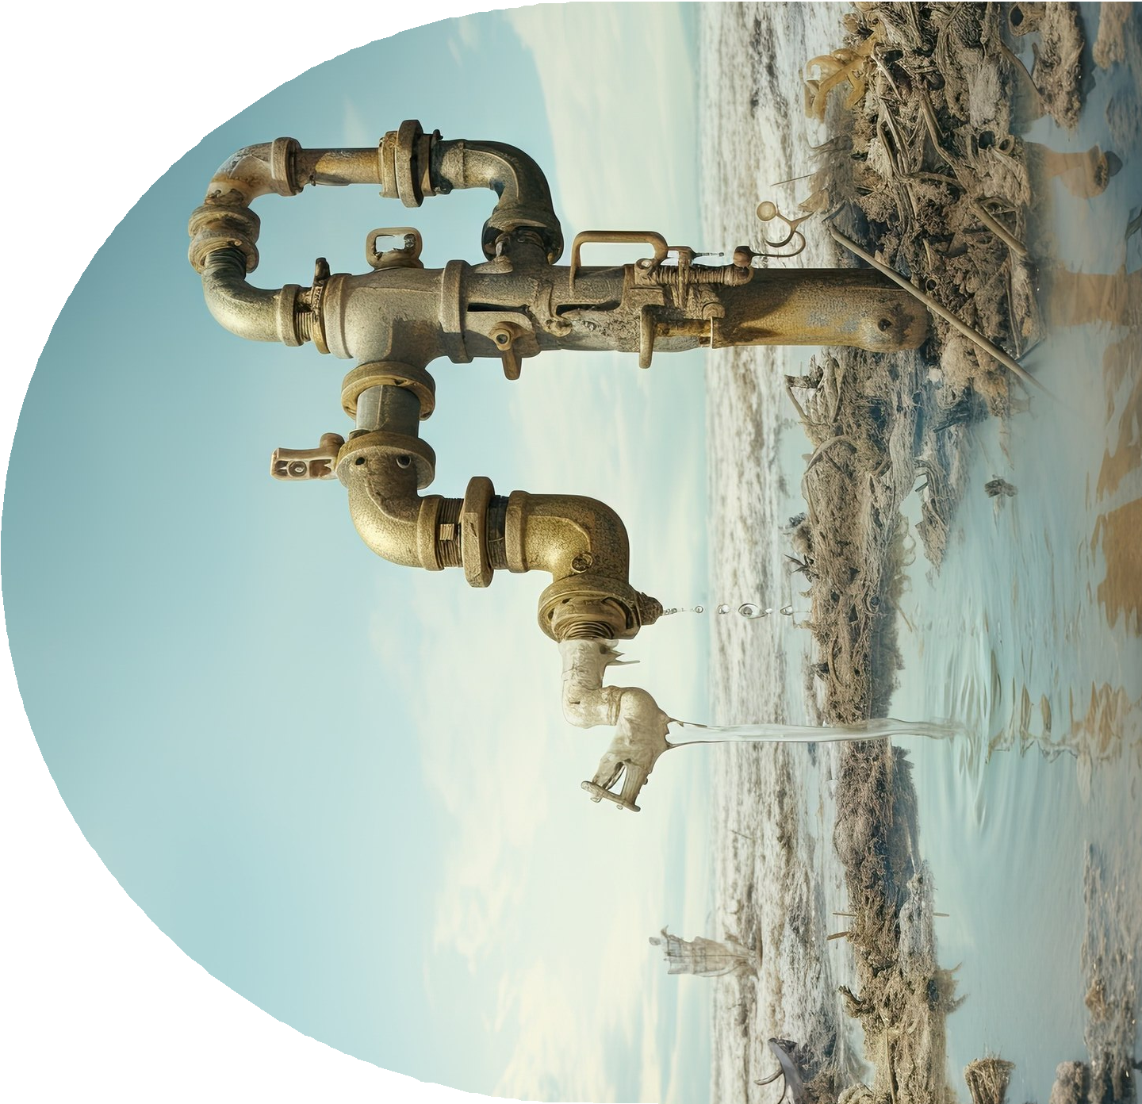

Reliability in Monitoring Systems
Reliability is a cornerstone of eﬀective water level monitoring. Systems must be robust and capable of functioning under various environmental conditions. This slide examines methods to ensure reliability, including redundancy, maintenance practices, and data validation techniques.

Slide 6


Case Studies and Applications
Real-world applications of advanced water level monitoring systems demonstrate their eﬀectiveness. Case studies from various sectors, including agriculture and urban planning, illustrate how precise monitoring leads to better outcomes. This slide presents notable examples and lessons learned.

Slide 7


Conclusion and Future Directions
In conclusion, advanced water level monitoring systems play a critical role in enhancing precision and reliability. As technology evolves, these systems will continue to improve, oﬀering even greater benefits for water management. Future research should focus on integrating AI and machine learning for predictive analytics.

Slide 8


Thanks!

